Slide 1


Plant Disease Prediction for Sustainable Agriculture
Aicte id: STU66698a1aab92b1718192666

Slide 2

Learning Objectives
Understanding Plant Diseases
Identify common plant diseases affecting crops.
Recognize the symptoms and signs of various plant diseases.
Importance of Disease Prediction
Explain the significance of early disease detection in sustainable agriculture.
Discuss the impact of plant diseases on crop yield and food security.
Introduction to Machine Learning and AI
Describe the basic concepts of machine learning and artificial intelligence.
Understand how machine learning can be applied to agricultural practices.
Image Processing Techniques
Learn the fundamentals of image processing and its role in disease detection.
Explore techniques for image acquisition, preprocessing, and analysis.
GOAL
Source :
www.freepik.com/

Slide 3
Tools and Technology used
Google Colab
Overview: Google Colab is a cloud-based Jupyter notebook environment that allows users to write and execute Python code in the browser.
Features:
Free access to GPUs and TPUs for accelerated computing.
Easy sharing and collaboration with others.
Pre-installed libraries for machine learning and data science.
Convolutional Neural Networks (CNN)
Overview: CNNs are a class of deep learning models specifically designed for processing structured grid data, such as images.
Key Components:
Convolutional Layers: Apply filters to input images to extract features.
Pooling Layers: Reduce the spatial dimensions of the feature maps, retaining important information while decreasing computational load.
Fully Connected Layers: Connect every neuron in one layer to every neuron in the next layer, typically used for classification tasks.
TensorFlow and Keras
TensorFlow: An open-source machine learning framework developed by Google, widely used for building and training deep learning models.
Keras: A high-level API for TensorFlow that simplifies the process of building and training neural networks.
Model Building: Users can easily create CNN architectures using Keras' sequential or functional API.
Training and Evaluation: Keras provides built-in functions for compiling, training, and evaluating models.
Data Preprocessing Tools
NumPy: A library for numerical computing in Python, used for handling arrays and performing mathematical operations.
OpenCV: A computer vision library that provides tools for image processing, such as resizing, color conversion, and augmentation.
Pandas: A data manipulation library that can be used for handling datasets, especially for loading and preprocessing image labels.
Visualization Libraries
Matplotlib: A plotting library used for visualizing data and model performance, such as displaying training loss and accuracy graphs.
Seaborn: A statistical data visualization library that can enhance the visual representation of data distributions and relationships.
Version Control and Collaboration
GitHub: A platform for version control and collaboration, allowing users to store and share their code repositories.
Google Drive: Integration with Google Colab for storing datasets and models, making it easy to access and share files.

Slide 4
Methodology
Define the Problem
Identify the specific problem (e.g., plant disease prediction).
Data Collection
Gather relevant datasets (e.g., images of plants).
Data Preprocessing
Resize images, normalize pixel values, apply data augmentation, and encode labels.
Environment Setup
Open Google Colab and import necessary libraries (TensorFlow, Keras, NumPy, etc.).
Model Architecture Design
Choose and build a CNN architecture using Keras, then compile the model.
Model Training
Split the dataset into training, validation, and test sets, then fit the model on the training data.
Model Evaluation
Evaluate the model on the test set and visualize performance metrics.
Model Optimization
Tune hyperparameters and apply regularization techniques to improve performance.
Model Deployment
Save the trained model and create a web application for predictions using frameworks like Streamlit.
Documentation and Reporting
Document the process and results, preparing a report for stakeholders.
Future Work
Identify areas for further research or improvements.

Slide 5
Problem Statement:
In the agricultural sector, plant diseases pose a significant threat to crop yield and quality, leading to substantial economic losses and food insecurity. Traditional methods of diagnosing plant diseases rely heavily on visual inspections by trained experts, which can be time-consuming, subjective, and often result in delayed responses to outbreaks.
This project aims to develop a Convolutional Neural Network (CNN) model that can automatically identify and classify various plant diseases from images of leaves. The model will utilize a dataset containing labeled images of both healthy and diseased plants to train the CNN. The goal is to achieve high accuracy in disease prediction, enabling farmers to quickly and accurately diagnose plant health issues.
By providing a reliable and efficient tool for early disease detection, this project seeks to empower farmers with actionable insights, reduce the reliance on chemical treatments, and promote sustainable agricultural practices. Ultimately, the successful implementation of this model will contribute to improved crop management, increased productivity, and enhanced food security.

Slide 6
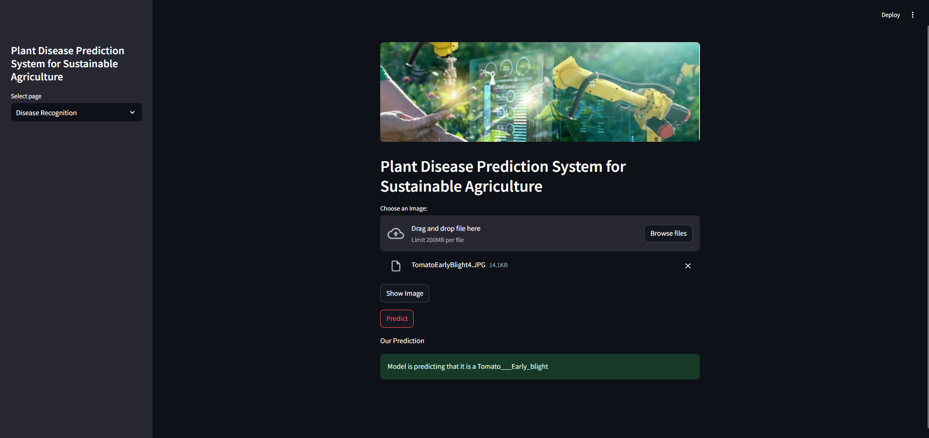

Solution:

Slide 7
Screenshot of Output:

Slide 8
Conclusion:
The development of a Convolutional Neural Network (CNN) model for plant disease prediction represents a significant advancement in the field of agricultural technology. By leveraging deep learning techniques, this project addresses the critical challenge of timely and accurate disease diagnosis, which is essential for maintaining crop health and maximizing yield.
Key takeaways from this project include:
Enhanced Detection: The CNN model demonstrates the ability to effectively classify various plant diseases based on leaf images, providing a reliable alternative to traditional diagnostic methods.
User Empowerment: By creating a user-friendly interface for farmers, the model facilitates quick decision-making, allowing for prompt interventions that can mitigate the impact of diseases on crops.
Sustainable Practices: Early disease detection contributes to more sustainable agricultural practices by reducing the need for chemical treatments and promoting healthier crop management strategies.
Future Potential: The successful implementation of this model opens avenues for further research and development, including the integration of additional features such as real-time monitoring and predictive analytics.

